Slide 1
Maryland Crash Reports
Presented by: Rachel Rolle

Slide 2
Table of Contents
Problem to Solve
Fitting Models
Data Description
Evaluation
Data Cleaning
Reflection
EDA Process

Slide 3

Problem to Solve
Traffic Crashes continue to be a major problem as most rely on transportation to get around
The goal of this project is to see what factors influence an injury from occurring
The hope is to promote measures that can be taken to prevent traffic crashes, such as improving road infrastructure, implementing traffic laws and regulations, promoting safe driving behaviors through education and awareness campaigns, and advancements in vehicle safety technology.

Slide 4
Data Description
Information of MV drivers involved in traffic collisions occurring on county and local roadways.
The oldest date recorded is 2015-01-01 and the latest is 2024-01-03.
1
3
2
There are 43 columns and 172,071 observations.
4
There were some nas omitted, yet that scratched the surface of what needs to be done with this dataset.

Slide 5
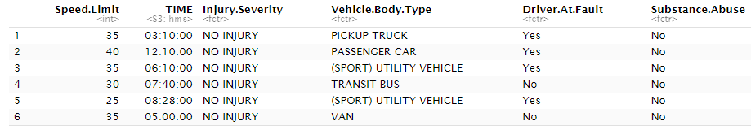
Data Cleaning
Date in correct format
Removed “Unknown” and “Other” and “N/A”
Reduced Factors: Substance Abuse to “yes” or “no”
Injury Severity from 5 to 2 levels (No injury or Injury)

Slide 6
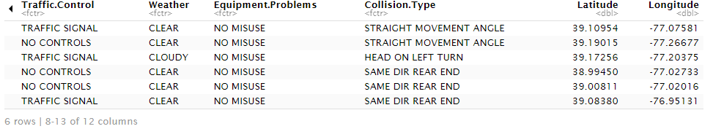
Data Cleaning Cont.
Down to 29,094 Rows and 12 columns

Slide 7
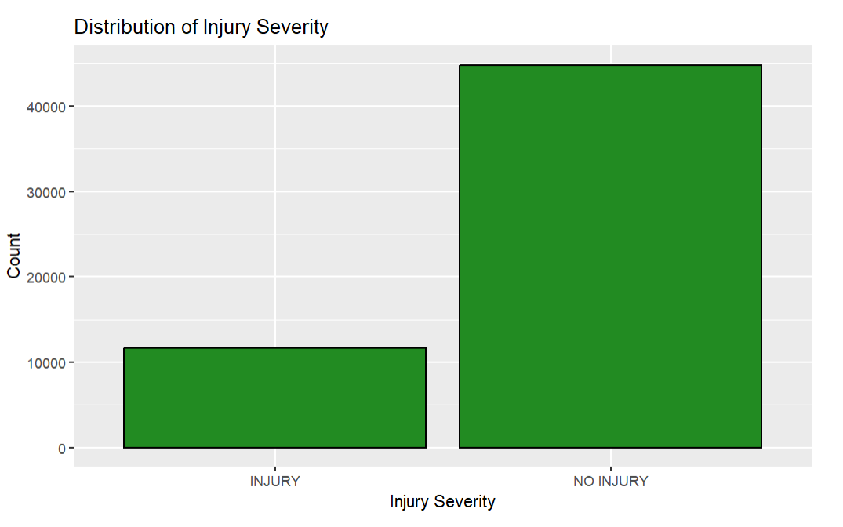
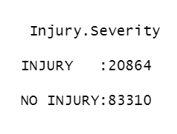
Data Cleaning Cont.
Address Undersampling

Slide 8
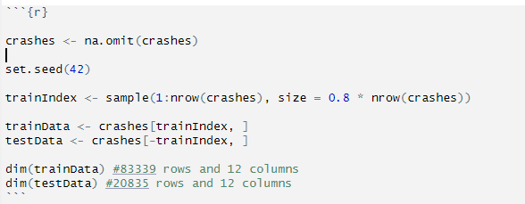
Train and Test Split

Slide 9
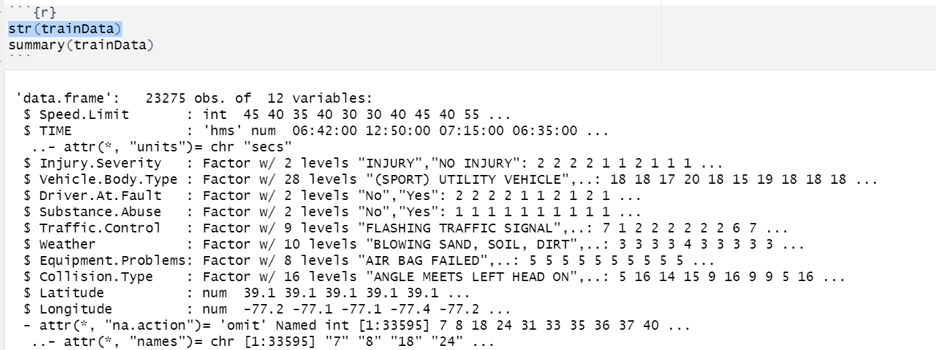
Exploratory Data Analysis
01
Ensure the variables have the appropriate types using the “str” function

Slide 10
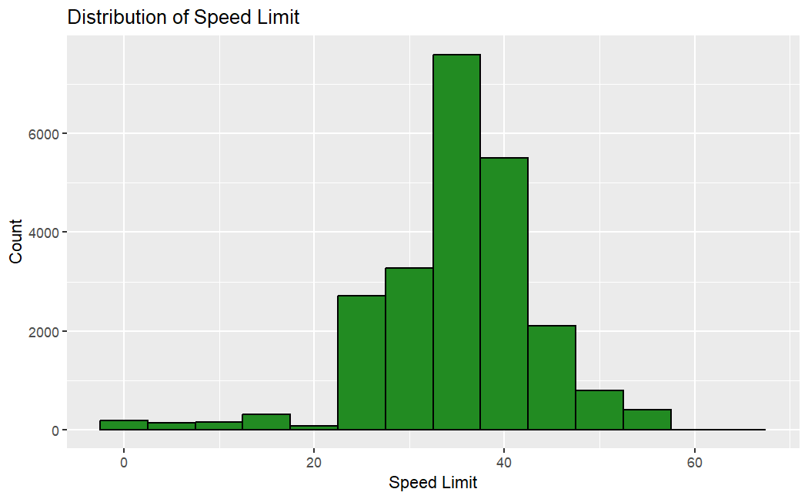
Numerical Variable
02
Speed limit is our only variable
It is skewed to the left but keep in mind, most roads do not go under 20 mph

Slide 11
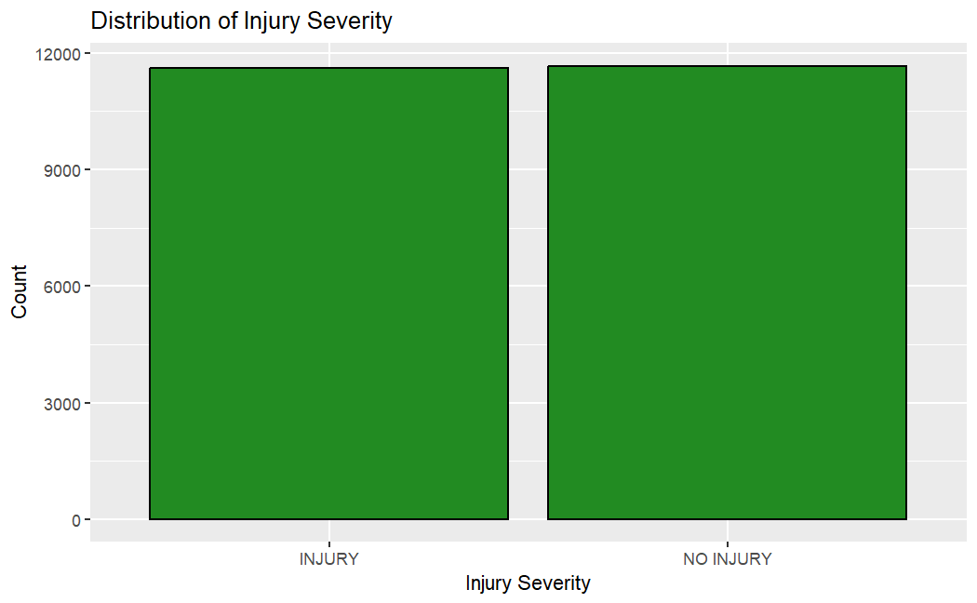
Categorical Variables
03
There are 9 categorical variables in the dataset
Injury Severity will be treated as our response variable

Slide 12
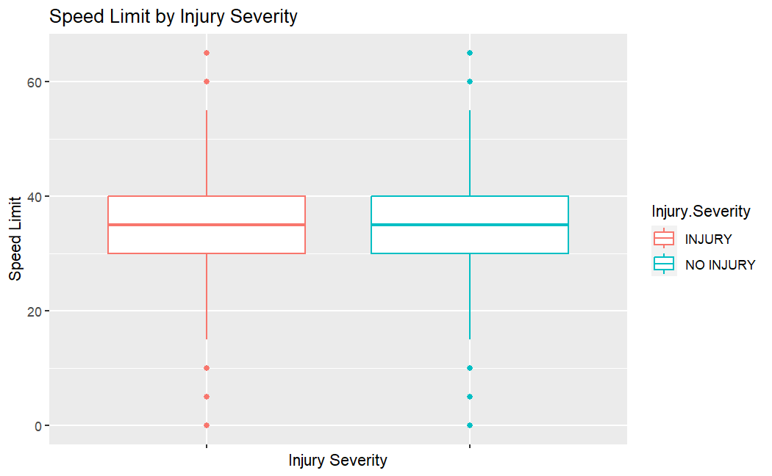
Exploring Relationships
03
Surprisingly speed limit does not seem to influence the Injury.Severity from the boxplot
We will make not of this when we observe it amongst all variables

Slide 13
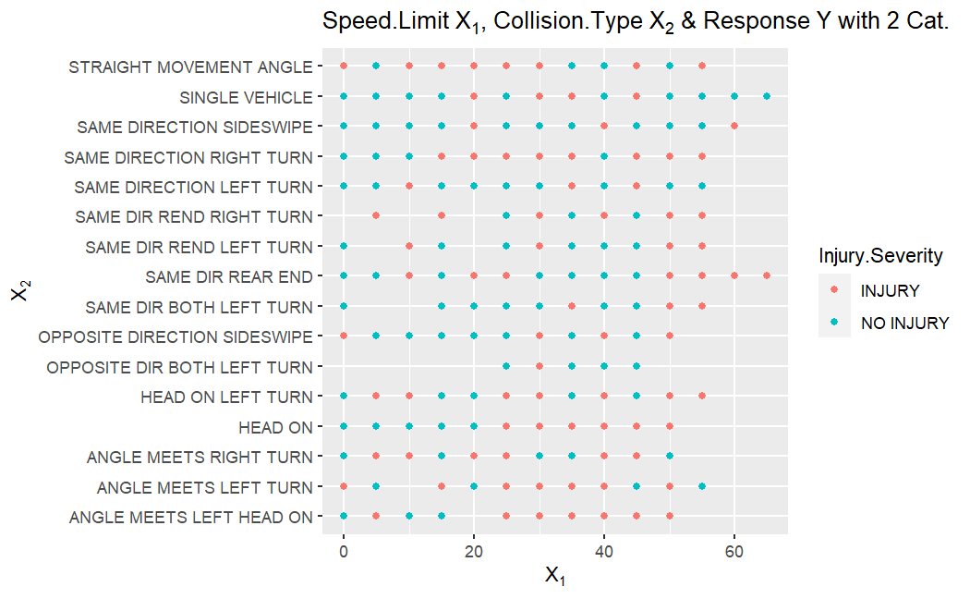
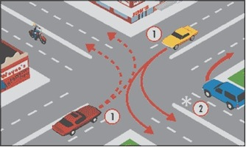
Exploring Relationships
04
Looking at relationship of Injury.Severity w/ Speed.Limit and Collision type
Same Direction Both Left Turn appears to have less frequent injuries
Angle meets left turn occurs regardless of speed limit

Slide 14
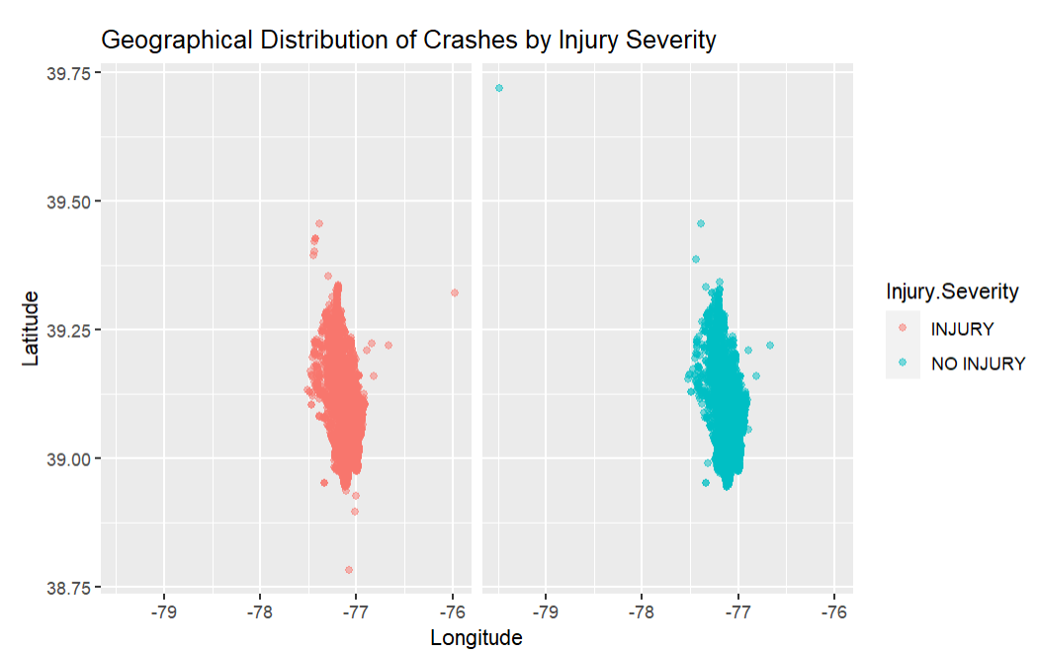
Exploring Relationships
05
Latitude and Longitude of Injury factors appear to be plotting similarly as well

Slide 15
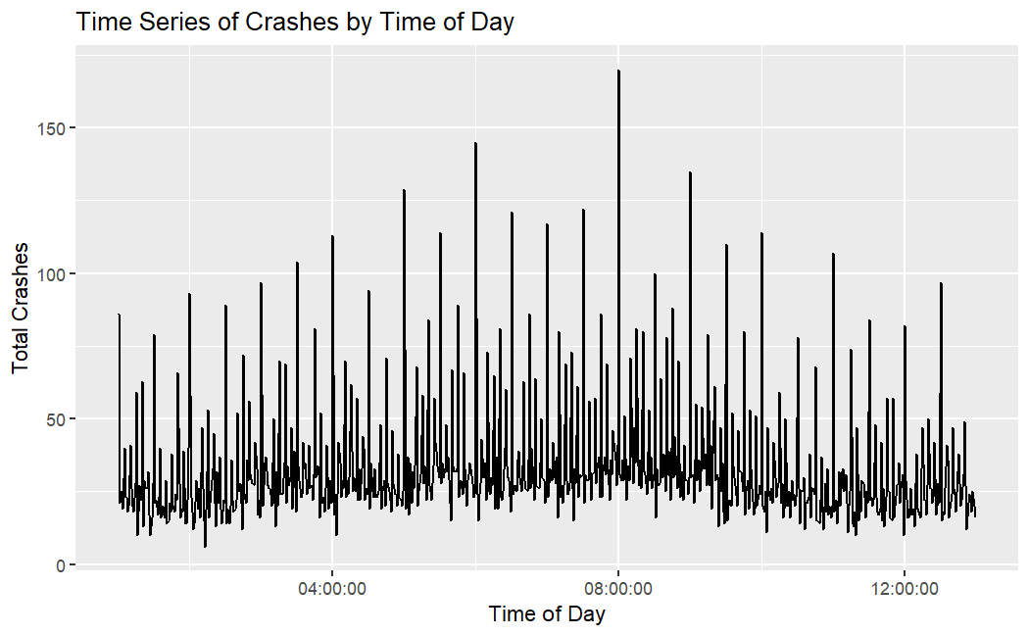
Exploring Relationships
06
Time appears to peak around the time people travel for work

Slide 16
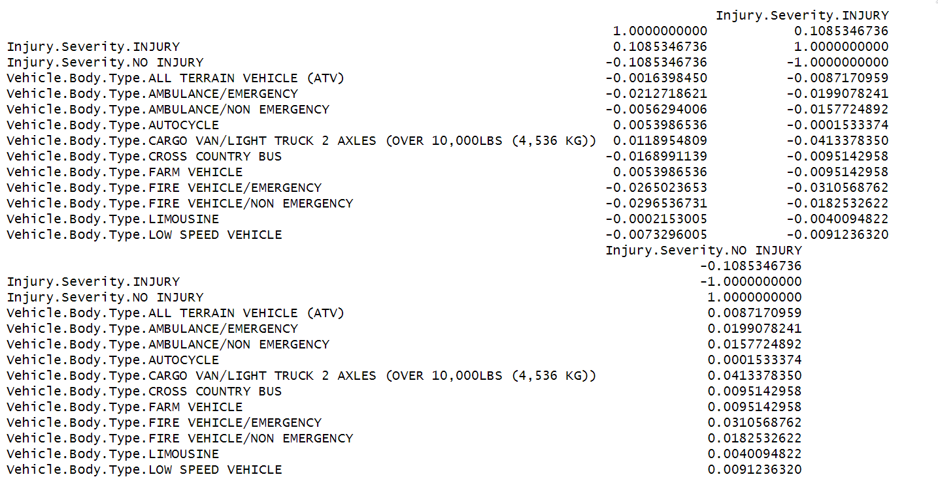
Correlation Matrix
Surprisingly only one variable seems to be correlated with the Injury.Severity
Notes:
No signs of multicollinearity
Therefore running a subset test is key to see which predictors are more favorable together

Slide 17
Selecting Variables
Using AIC and BIC
The AIC formula is for favorable was a complex problem like this

Slide 18
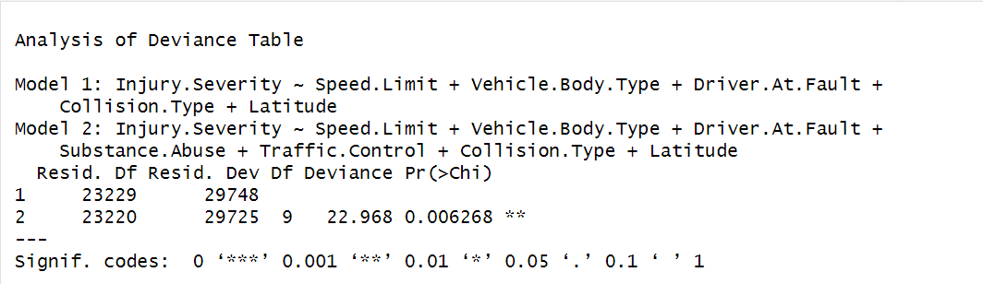
Selecting Variables Cont.

Slide 19



Model Training
Injury Severity is over Dependent Variable
Predictors(Speed.Limit + Vehicle.Body.Type + Driver.At.Fault + Substance.Abuse + Traffic.Control + Collision.Type + Latitude)
01 | Logistic Regression
02 | Quadratic Discriminant Analysis (QDA)
03 | Random Forest
04 | Support Vector Machine (SVM)

Slide 20
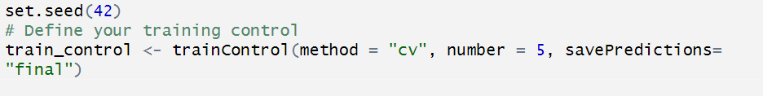
Tuning the Models
Given the data’s complex nature, using cross validation for the 4 models were essential to reduce number of trials.

Slide 21
Results
 | Injury (TPR) | No Injury (TNR) | Accuracy | Predictors
Logistic Regression | 0.691 | 0.559 | 0.625 | 8
QDA | 0.694 | 0.406 | 0.550 | 3 (Lat, TIME, Speed.Limit)
Random Forest | 0.7627 | 0.469 | 0.616 | 8
SVM | 0.7433 | 0.508 | 0.626 | 8
01
Notes:
Keeping in mind QDA could not handle multiple classifications; yet it does a fairly great job with only 3 predictors; so to keep the model simple this would be a more favorable model

Slide 22
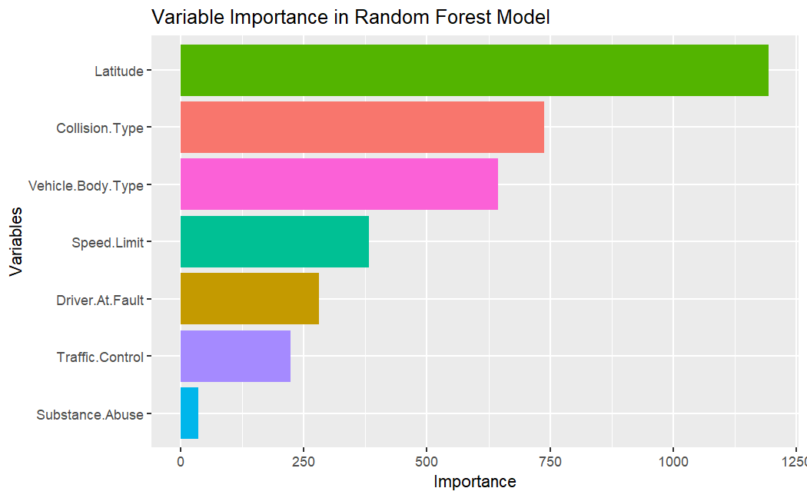
Results Cont.
Notes:
Used MeanDecreaseGini, the more important the variable is considered to be.
Huge surprise from looking at the latitude solely with injury variables did not look like there was much of difference
In was selected using AIC and is now considered the most importance variable
There must have been a lot of noise in occurring in the data point. Thinking about our human intuition often struggles with non-linear relationships, which can be prevalent in large data sets. Visual analysis might miss these complex patterns.

Slide 23
Reflections
What went well?
Identifying injury
It took combining Injury.Severity factors from 5 to 2 levels
Balancing the classes
Helpful?
Factors such as traffic safety, vehicle problems, collision.type, driver.at.fault can aid in predicting injury occurring is beneficial
Improvements?
Obtaining reliable data
Explore additional features
Notes:
In domains like traffic safety or insurance claims, accurately predicting injuries can be critical for allocating resources, improving safety measures, or processing claims efficiently.
Data Quality: Ensuring the quality and relevance of the data used for training and evaluation.
Feature Engineering: Exploring additional features or transforming existing ones to better capture patterns related to injuries. (42 features; also vehicle type add about 28 classes–reducing to 10 could be meaningful)

Slide 24
Thank you.

